Slide 1
Food Ordering Website using the MERN stack
Ishika Mangla
2110991725
G-27

Slide 2
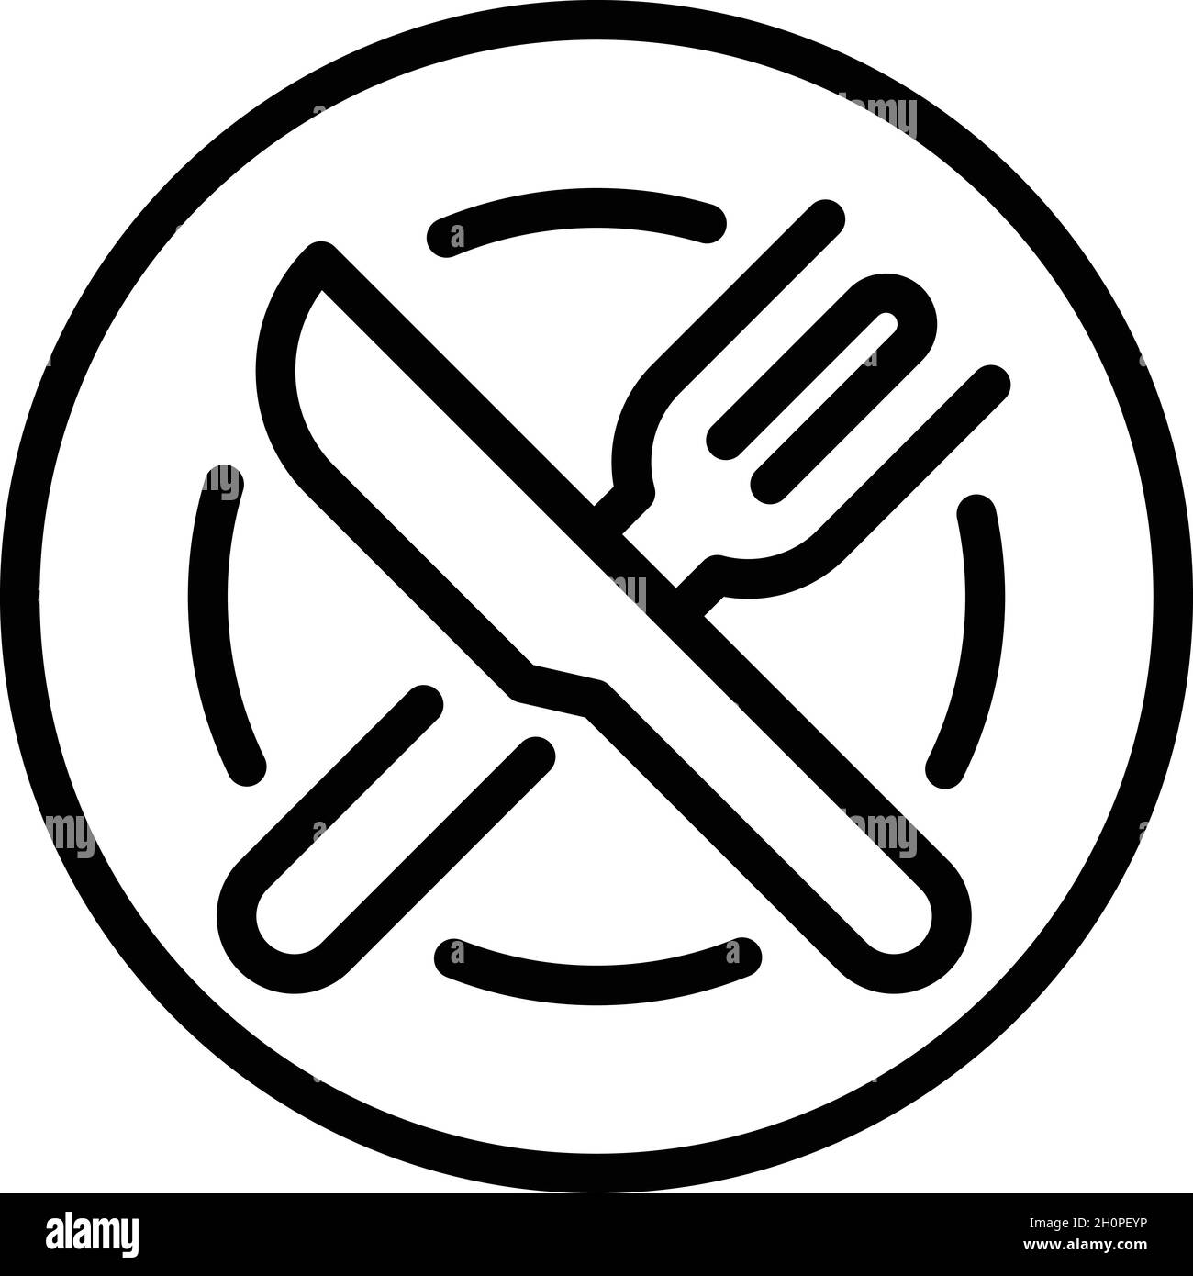
Introduction
Food ordering website named goFood.
It is more dynamic.
It has three categories of food – starters, pizza and biryani/rice.
Each category has its own food data stored in json file using key value pairs.

Slide 3
Technology
WHAT IS MERN STACK DEVELOPMENT?
MERN is an acronym used to describe a specific set of Javascript based technologies that are used in the web application development process. MERN includes the following open-source components:
Mongo DB
Express JS
React JS
Node JS
MongoDB
NoSQL database.
Document-oriented like JSON.
Mongoose API

Slide 4
Node.js
Very powerful JavaScript-based platform built on Google Chrome's JavaScript V8 Engine.
Single Threaded but Highly Scalable.
Callbacks and Event Driven.
Node Package Module (NPM).

Slide 5
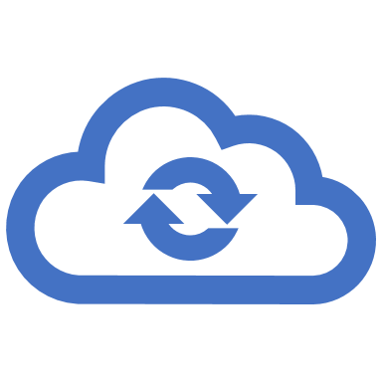
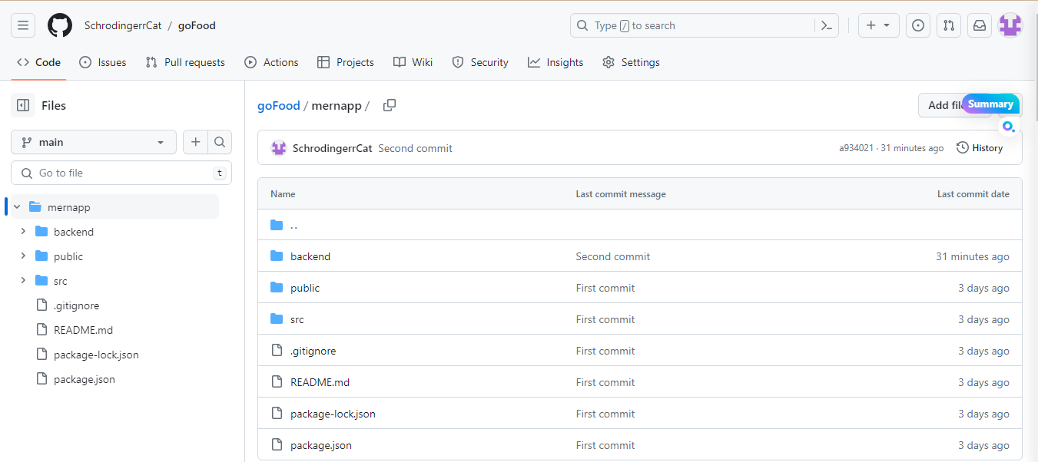
Services Used
GitHub : Store the source-code

Slide 6
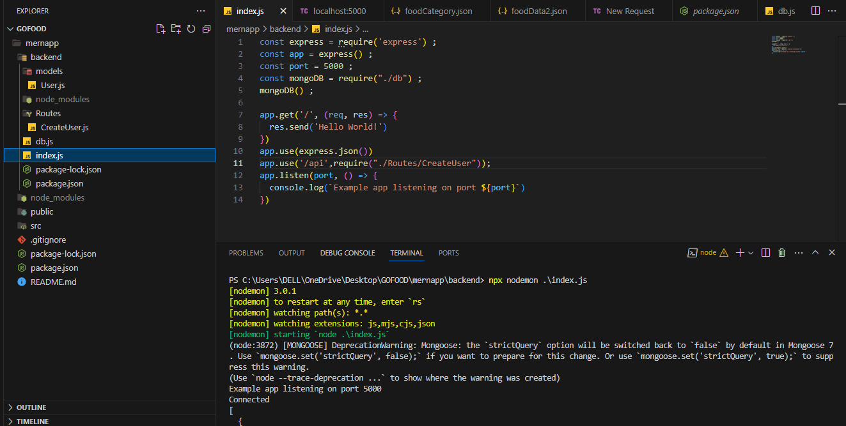
TO START THE SERVER

Slide 7
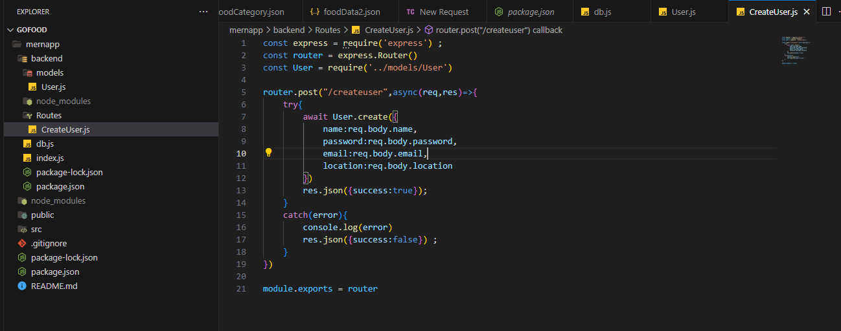
CREATING A USER ROUTE DATA

Slide 8
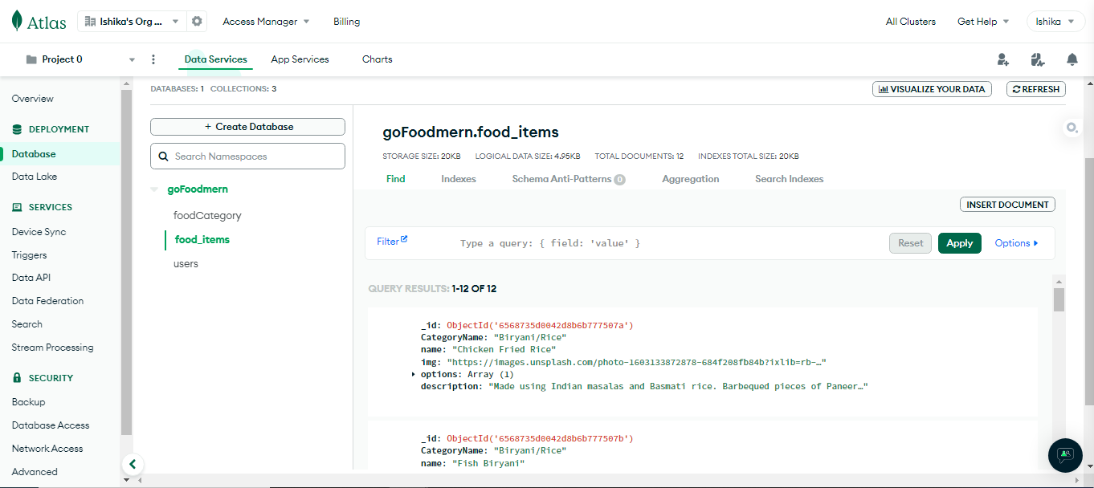
CONNECTING WITH MONGODB DATABASE USING MONGOOSE IN EXPRESS JS

Slide 9
Thank You!!!

